Slide 1
Computer Networks Local Area Networks
Amitangshu Pal
Computer Science and Engineering
IIT Kanpur

Slide 2
MAC Address and Framing

Slide 3
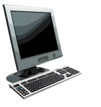
MAC addresses
MAC (or LAN or physical) address:
48-bit MAC address (for most LANs) burned in NIC ROM, also sometimes software settable
Each interface on LAN has an unique MAC address
e.g.: 1A-2F-BB-76-09-AD
1A-2F-BB-76-09-AD
LAN
(wired or wireless)
71-65-F7-2B-08-53
58-23-D7-FA-20-B0
0C-C4-11-6F-E3-98

Slide 4
MAC addresses
MAC address allocation administered by IEEE
Manufacturer buys portion of MAC address space (to assure uniqueness)
MAC address: portability
Can move interface from one LAN to another

Slide 5
Ethernet frame structure
Sending interface encapsulates IP datagram (or other network layer protocol packet) in Ethernet frame
type
preamble
dest.
address
source
address
data (payload)
CRC
Preamble:
Used to synchronize receiver, sender clock rates
7 bytes of 10101010 followed by one byte of 10101011

Slide 6
Ethernet frame structure
type
preamble
dest.
address
source
address
data (payload)
CRC
Addresses: 6 byte source, destination MAC addresses
If adapter receives frame with matching destination address, or with broadcast address, it passes data in frame to network layer protocol
Otherwise, adapter discards frame
Type: indicates higher layer protocol
Mostly IP but others possible, e.g., Novell IPX, AppleTalk
Used to demultiplex up at receiver
CRC: Cyclic redundancy check at receiver
Error detected: frame is dropped

Slide 7
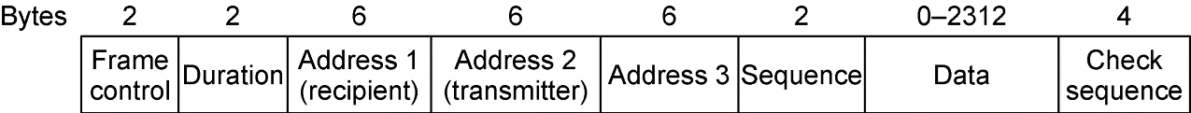
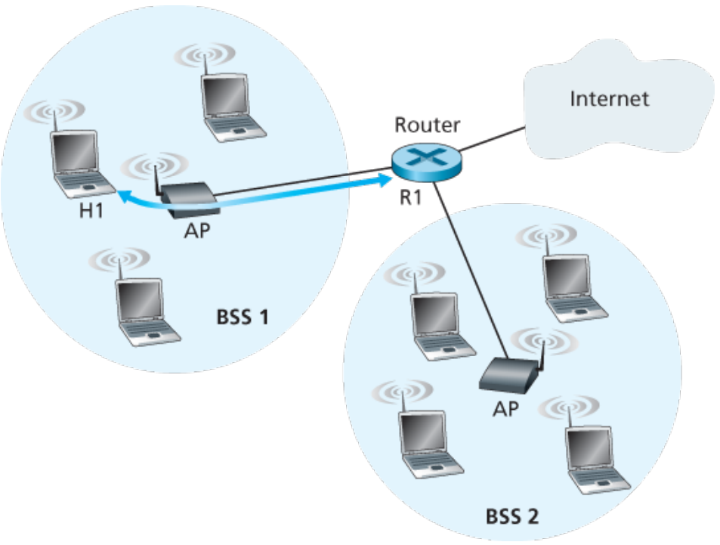
802.11 frame structure

Slide 8
Ethernet Switches

Slide 9

Ethernet: physical topology
Bus: popular through mid 90s
All nodes in same collision domain (can collide with each other)
Switched: prevails today
Active link-layer 2 switch in center
Each “spoke” runs a (separate) Ethernet protocol (nodes do not collide with each other)
Bus
Switched

Slide 10
Ethernet switch
Switch is a link-layer device
Store, forward Ethernet frames
Examine incoming frame’s MAC address, selectively forward frame to one-or-more outgoing links when frame is to be forwarded on segment, uses CSMA/CD to access segment
Transparent: hosts unaware of presence of switches
Plug-and-play, self-learning
Switches do not need to be configured

Slide 11
Ethernet switch
Hosts have dedicated, direct connection to switch
Switches buffer packets
Ethernet protocol used on each incoming link, so:
No collisions; full duplex
Each link is its own collision domain
A
C’
B
1
2
6
3
5
4
B’
C
A’
Switching: A-to-A’ and B-to-B’ can transmit simultaneously, without collisions
switch with six interfaces (1,2,3,4,5,6)
https://www.ciscopress.com/articles/article.asp?p=2111396

Slide 12

Ethernet switch
Hosts have dedicated, direct connection to switch
Switches buffer packets
Ethernet protocol used on each incoming link, so:
No collisions; full duplex
Each link is its own collision domain
A
C’
B
1
2
6
3
5
4
B’
C
A’
Switching: A-to-A’ and B-to-B’ can transmit simultaneously, without collisions
But A-to-A’ and C to A’ can not happen simultaneously
switch with six interfaces (1,2,3,4,5,6)
https://study-ccna.com/half-duplex-and-full-duplex/

Slide 13
Switch forwarding table
Q: How does switch know A’ reachable via interface 4, B’ reachable via interface 5?
A
C’
B
A: Each switch has a forwarding table, each entry:
(MAC address of host, interface to reach host, time stamp)
1
2
6
3
5
4
B’
C
A’
Q: How are entries created, maintained in forwarding table?

Slide 14
Switch: self-learning
Source: A
Switch learns which hosts can be reached through which interfaces
Dest: A’
A A’
A
C’
B
When frame received, switch “learns” location of sender: incoming LAN segment
1
2
6
3
5
4
Records sender/location pair in switch table
B’
C
A’
MAC addr interface TTL
Forwarding table
(initially empty)
A
1
60

Slide 15
Self-learning and Forwarding
Source: A
Dest: A’
Frame destination, A’, location unknown: flood
A A’
A
C’
B
Destination A location known:
selectively send
on just one link
1
2
6
A A’
A A’
A A’
A A’
A A’
3
5
4
B’
C
A’ A
A’
MAC addr interface TTL
A
1
60
switch table
(initially empty)
A’
4
60

Slide 16


Interconnecting switches
Self-learning switches can be connected together:
S₄
S₁
S₃
A
S₂
D
F
I
B
C
E
G
H
Q: Sending from A to G - how does S₁ know to forward frame destined to G via S₄ and S₃?
A: Self learning! (works exactly the same as in single-switch case!)

Slide 17
Switch: frame filtering/forwarding
When frame received at switch:
1. Record incoming link, MAC address of sending host
2. Index forwarding table using MAC destination address
3. If entry found for destination then {
if destination on segment from which frame arrived then drop frame
else forward frame on interface indicated by entry
}
else flood /* forward on all interfaces except arriving interface */

Slide 18
Virtual LAN

Slide 19
Virtual LANs (VLANs)
Single broadcast domain:
Scaling: all layer-2 broadcast traffic (i.e. unknown MAC) must cross entire LAN
Efficiency, security, privacy issues
Computer
Science
EE
Administrative issues:
CS user moves office to EE - physically attached to EE switch, but wants to remain logically attached to CS switch

Slide 20
Port-based VLANs
Port-based VLAN: switch ports grouped (by switch management software) so that single physical switch ……
Virtual Local Area Network (VLAN)
Switch(es) supporting VLAN capabilities can be configured to define multiple virtual LANS over single physical LAN infrastructure
1
7
9
15
2
8
10
16
…
…
EE (VLAN ports 1-8)
CS (VLAN ports 9-15)
… operates as multiple virtual switches
1
7
9
15
2
8
10
16
…
…
EE (VLAN ports 1-8)
CS (VLAN ports 9-15)

Slide 21
Port-based VLANs
Traffic isolation: frames to/from ports 1-8 can only reach ports 1-8
can also define VLAN based on MAC addresses of endpoints, rather than switch port
Dynamic membership: ports can be dynamically assigned among VLANs
1
7
9
15
2
8
10
16
Forwarding between VLANS: done via routing (just as with separate switches)
in practice vendors sell combined switches plus routers
…
…
EE (VLAN ports 1-8)
CS (VLAN ports 9-15)

Slide 22
VLANS spanning multiple switches
1
7
9
15
1
3
5
7
2
8
10
16
16
2
4
6
8
…
…
…
EE (VLAN ports 1-8)
CS (VLAN ports 9-15)
Ports 2,3,5 belong to EE VLAN
Ports 4,6,7,8 belong to CS VLAN
Trunk port: carries frames between VLANS defined over multiple physical switches
frames forwarded within VLAN between switches must carry VLAN ID info
802.1q protocol adds/removed additional header fields for frames forwarded between trunk ports

Slide 23
Summary
Local area networks:
MAC addresses and framing
Ethernet switch and self learning
Virtual LANs

